Slide 1
Decolonial Wikipedia Editing
Image from Wikimedia commons

Slide 2
How can Wikipedia editing contribute to the decolonisation of knowledge?

Slide 3
Why Edit Wikipedia?
Wikipedia is a global resource with a huge number of readers
Editing helps you learn
Sharing information is powerful
Wikipedia is the backbone of the internet
Wikipedia aims to be neutral*
Notes:
To avoid overloading the slides with text, use speaker notes to add more detail and prompts.

Slide 4
Context
Wikipedia’s writers are mostly from Europe and North America​
Only about 10% of Wikipedia's writers are women​
Only about 18% of biographies on English Wikipedia are about women
Wikipedia is biased!
Notes:
To avoid overloading the slides with text, use speaker notes to add more detail and prompts.

Slide 5
Context
Other causes
of bias
Digital poverty & unequal access to technology
English is dominant in many online spaces
Notes:
To avoid overloading the slides with text, use speaker notes to add more detail and prompts.

Slide 6
Context
Wikipedia is flawed
But we can change it!
Notes:
To avoid overloading the slides with text, use speaker notes to add more detail and prompts.

Slide 7
Context

Slide 8
Context
Wikipedia is a global resource, read 20 billion times a month​
Visibility on Wikipedia translates to visibility online​
Used by Amazon and Google to power personal assistants

Slide 9
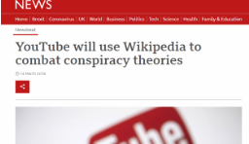
Context
​
Used by YouTube and Facebook against
fake news and conspiracy theories
Used by the public and professionals​
Journalists use Wikipedia to brush up
on subjects & decide who to talk to

Slide 10
Our Aims
Increase the visibility and credibility of under-represented artists, researchers and events
Support students and staff to become Wikipedia editors and creators with decolonisation at the heart of our efforts.
An opportunity for you to play an active role in decolonising knowledge & improve your research, writing and editing skills.

Slide 11
Editing Wikipedia

Slide 12
Making an account
Demonstration in the video

Slide 13
Profile Declaration
If you’re editing as part of any paid UAL role:​
“I work for the University of Arts London and am editing Wikipedia as part of my work. I am aware of the conflict of interest guidelines as well as policies around content, and will work within them.​”
​
If you’re not being paid:​
“I am a current student at the University of Arts London. I am currently working on editing Wikipedia, contributing to the decolonisation of the curriculum, at the London College of Communication. I will abide by the conflict of interest guidelines as well as policies around content. I am receiving training on how to edit as part of a project with LCC and Wikimedia UK. If you have questions you can contact Richard Nevell at richard.nevell@wikimedia.org.uk​”

Slide 14
What counts as an edit?
Minor edits
e.g. small corrections, small additions
Major/extensive edits
e.g. major page overhauls, addition of extensive research

Slide 15
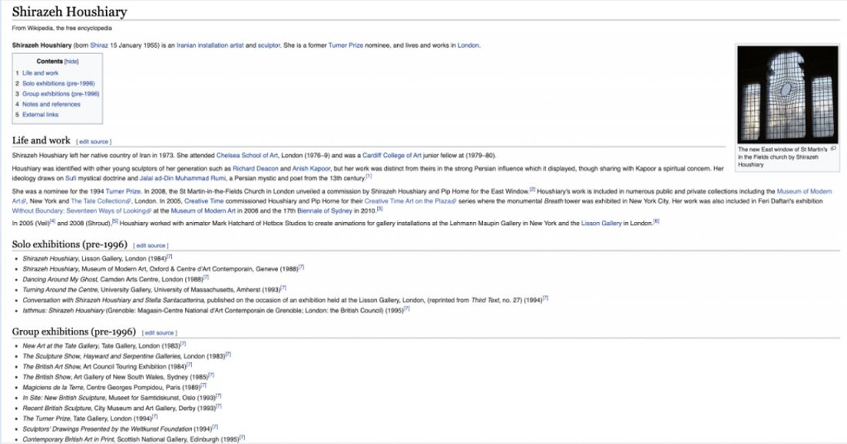
new!

Slide 16
new!

Slide 17
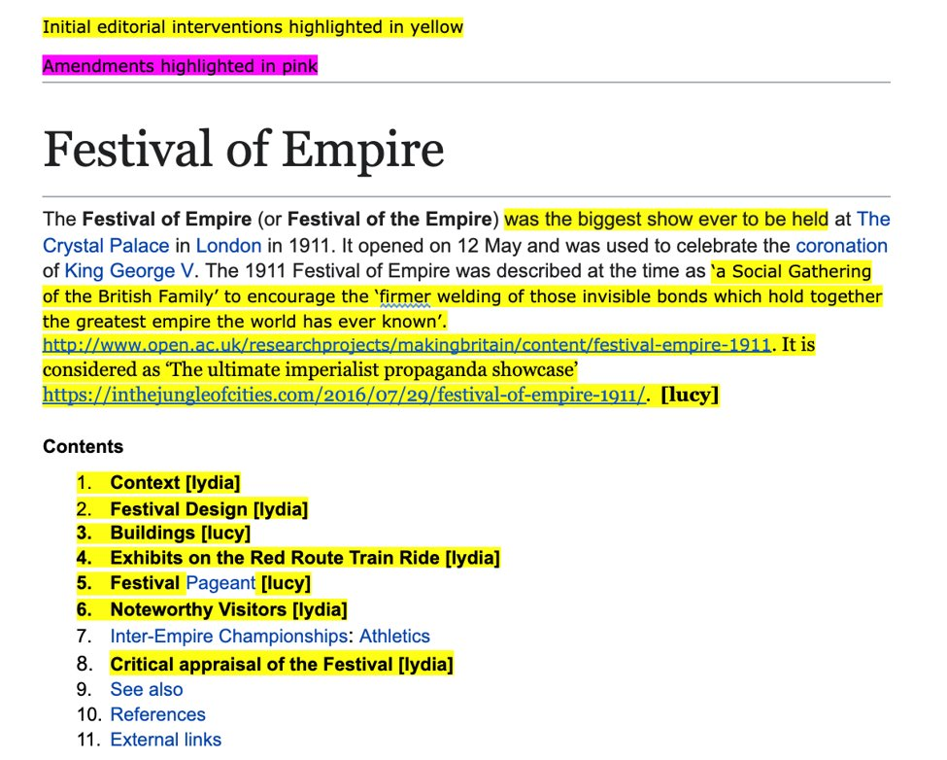

Slide 18
Editing demonstration
Navigation
Using the visual editor​
Adding a citation/Wiki-link​
Adding an image and caption​
Adding notes and comments​
Viewing edit history and talk

Slide 19
Images
An image already in WikiCommons (Lucy e.g. Crystal Palace Bowl)​
Your own work​
Someone else’s work or an image of someone else: ​
Licensing description and copyright tags​
Fair use​
Different processes depending whether it is:​
Notes:
To avoid overloading the slides with text, use speaker notes to add more detail and prompts.

Slide 20
Creating a page

Slide 21
Account procedure
To make a new page you need to:
Make 10 edits (they can be really small!)
Have a Wikipedia account for 4 at least days

Slide 22
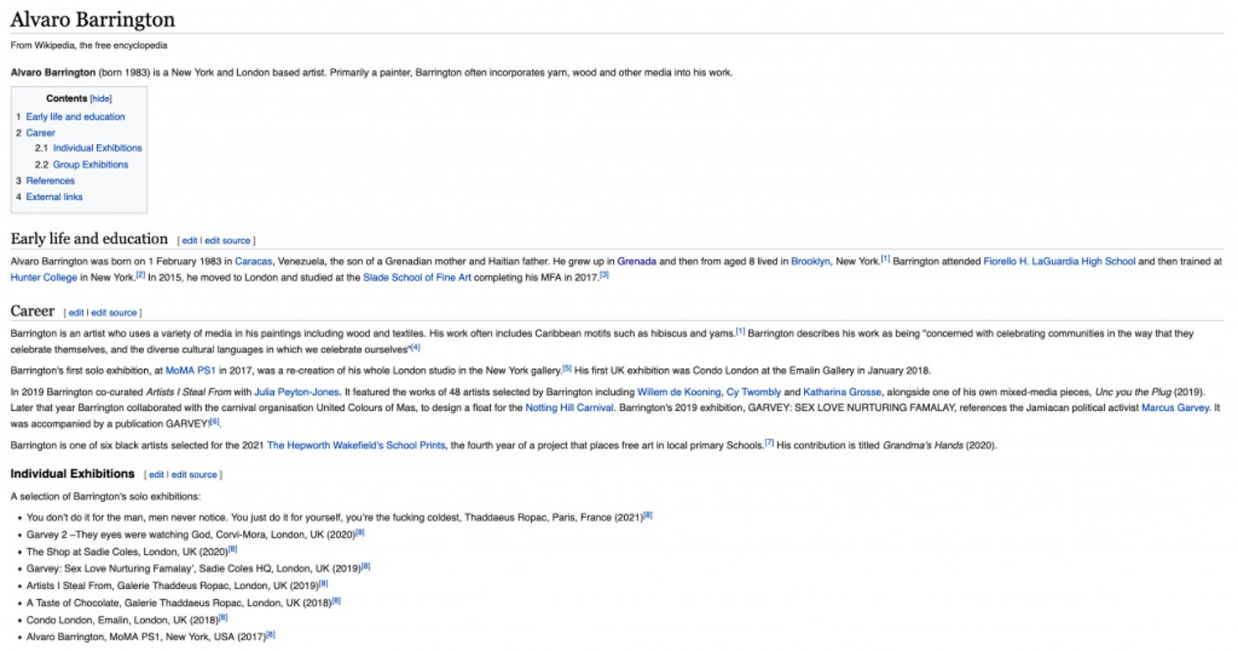
http://mattlingard.com/writing-wikipedia/ ​

Slide 23
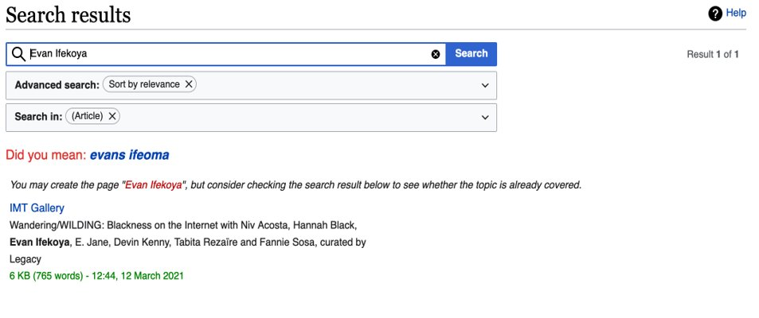
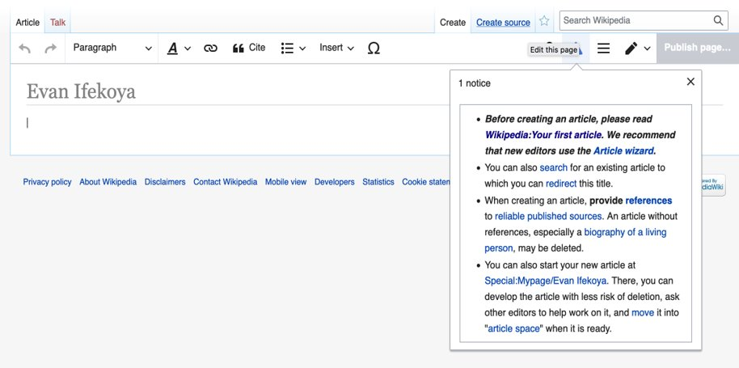
Creating a new page
Red links Stubs Create from search

Slide 24
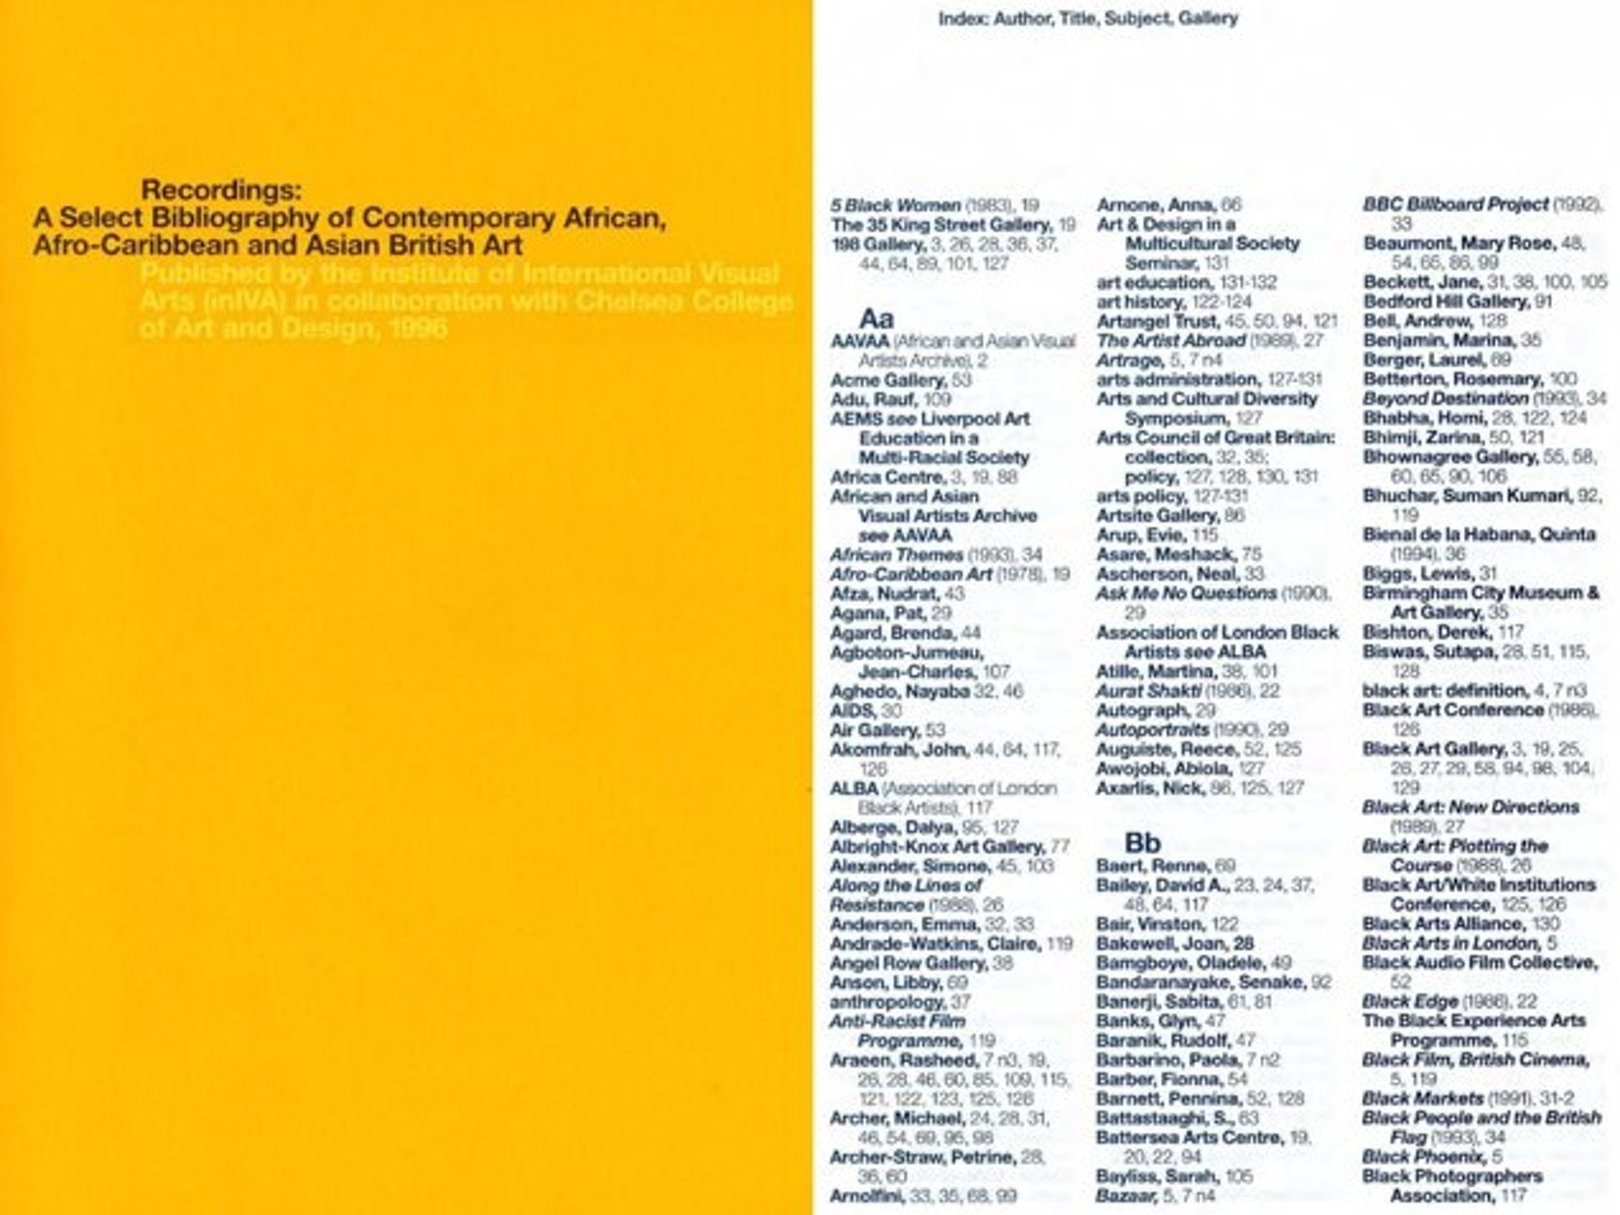

Slide 25
Ethics

Slide 26
Does everyone want a Wikipedia page?
Think about getting in touch first!

Slide 27
The Chicken and Egg Issue
What if the sources available look no more credible than the Wikipedia page you want to create or edit? ​
​
Hidden/lost histories
“Scraping the barrel”​

Slide 28
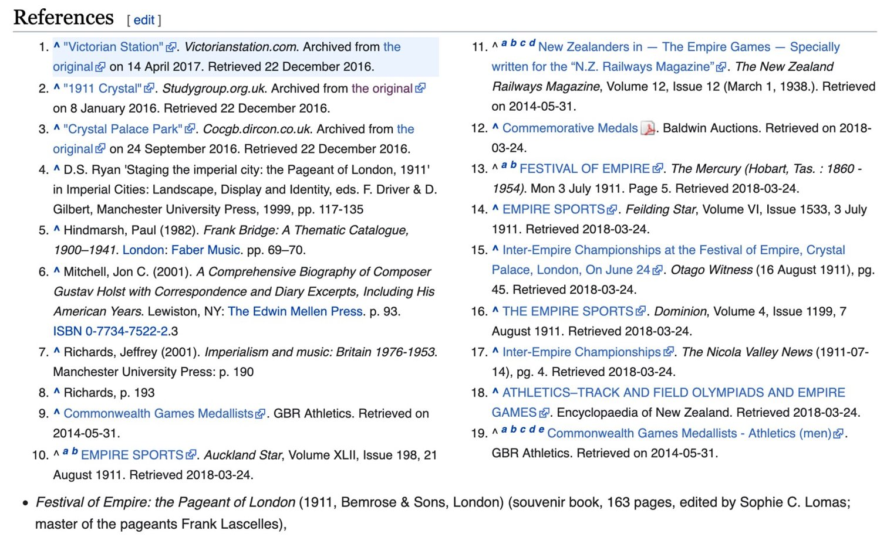
​
https://en.wikipedia.org/wiki/Festival_of_Empire ​
​

Slide 29
What’s in the barrel?
If we search 1911 Festival of Empire, what kind of online sources come up that offer new imagery and facts?​
​
Would these sources pass Wikipedia notability criteria?​
​
What other things should we be cautious about?

Slide 30
https://decolonisingwikipedianetwork.myblog.arts.ac.uk/
Image from Wikimedia commons

